Slide 1


Data analysis jobs in NYC government
By: Wenhua Zhao

Slide 2

Work for City of New York as Data Analyst？
Opportunities?
Good pay?
BRIGHT FUTURE?
The dataset contains current job postings available on the City of New York’s official jobs site

Slide 3
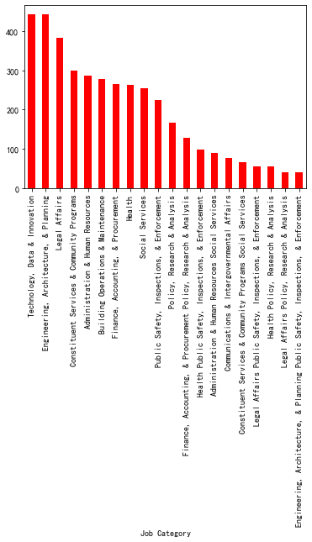
What kind of people NYC needs(Top 20)

Slide 4
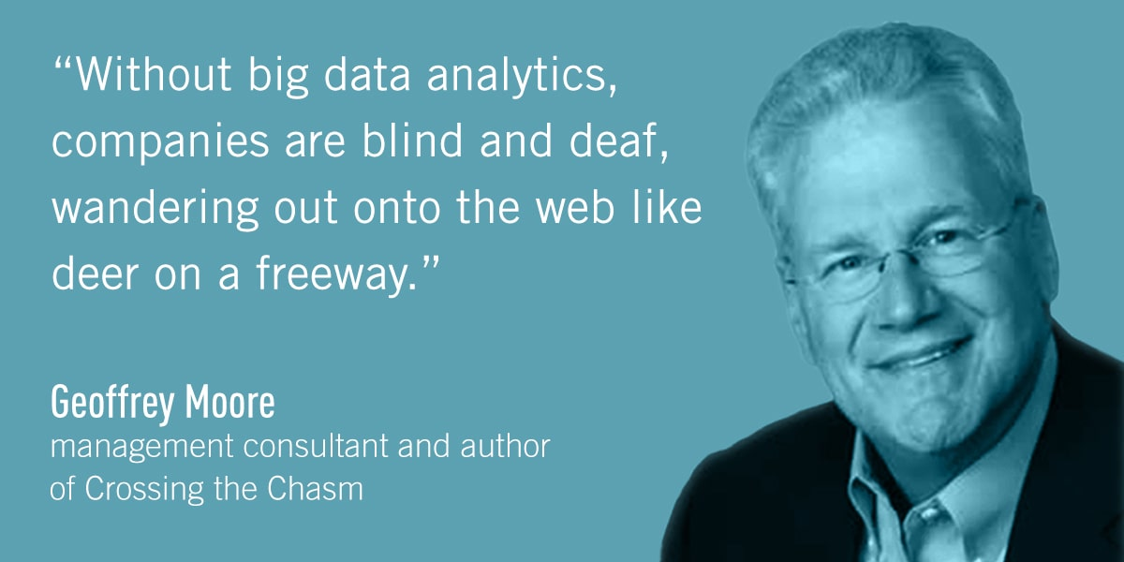
According to the dataset data related jobs are in demand

Slide 5

Let’s focus on Data Analyst and Business Analyst jobs since we are Launching Our Dream Career in Data Science at

Slide 6
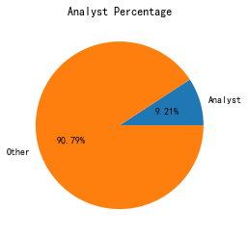
4885 job postings are on the City of New York’s official jobs site and around 10% are related to data analysis

Slide 7
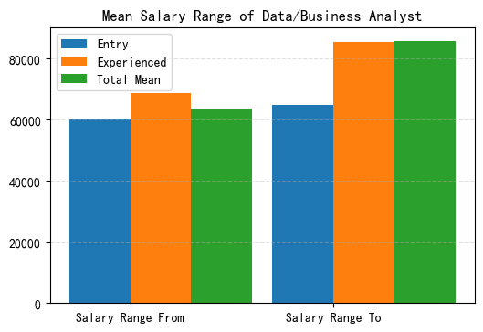
Good pay is always a good motivation

Slide 8


all jobs’ mean salary
data analysis’s mean salary
Almost the same

Slide 9

Is there a big difference on salary between internal hiring and external hiring?

Slide 10

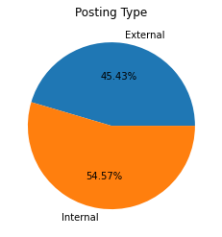
45.3% jobs are open for external
54.57% jobs are open for internal

Slide 11
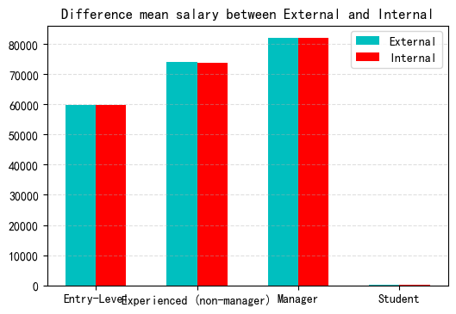
There is no difference on salary between internal hiring and external hiring. However, internal hiring is less competitive.

Slide 12


What about the future if hired?
Will salary go up a lot if I’m experienced?
Compare different career levels

Slide 13
Four different career level jobs are available, of course paid differently
see next slide
Entry
Experienced
Career Levels
Manager
Executive

Slide 14

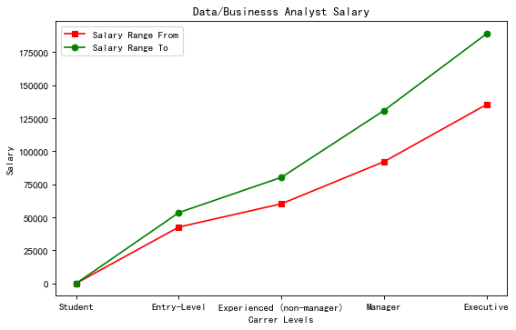
Mean salary range of data/business anylsts for different career levels

Slide 15
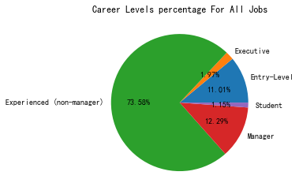
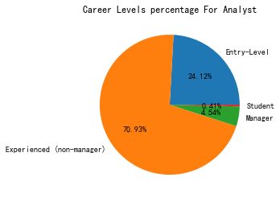
A quarter of data jobs are Entry_level jobs.

Slide 16
conclusion
Oppotunities OK
more entry level jobs for data analysis
internal oppotunities are good
mean pay is the same with NY mean
salary does not jump a lot when become experienced

Slide 17

If I have more time... I’ search more about
Degree
｛
Requirement for data jobs
Bootcamp
Salary
｛
Job postings
of tech company
Requirement

Slide 18


